Slide 1
WELCOME TO MY CIT FINAL PROJECT
CONTENTS
RESUME
SPREADSHEET

Slide 2
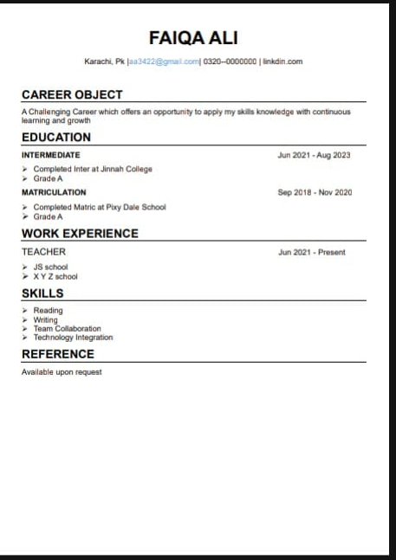
RESUME
The following section provides an overview of my professional and Personal background, including my Personal details, my Career Object, Education, Work Experience and Key Skills.

Slide 3
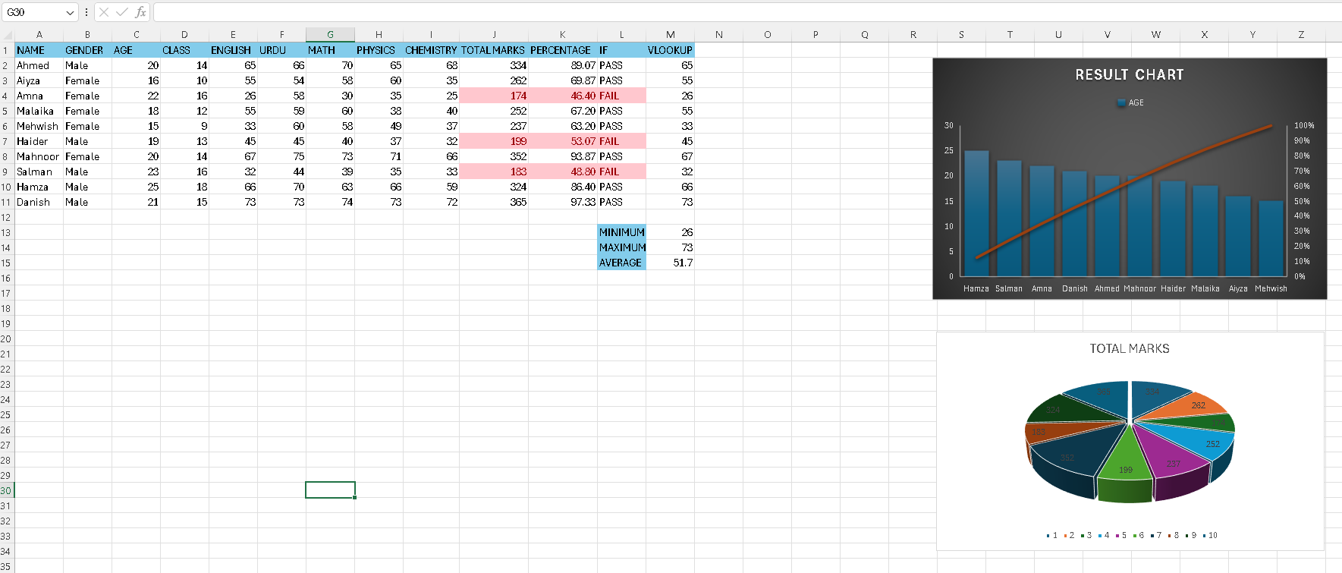
SPREADSHEET
Here is my Spreadsheet, which consists of…
Students result marks
Formulas
Data Valitation
Conditional Formatting
Charts
Pivot Table

Slide 4
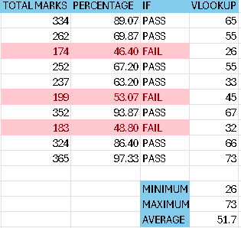
FORMULAS
SUM
=SUM(cell1+cell2)
AVERAGE
=AVERAGE(whole raw)
MINIMUM
=MINI(whole raw)
MAXIMUM
=MAX(whole raw)
IF
=IF(total marks>=200,”pass”,”fail”)
VLOOKUP
=VLOOKUP(name cell, whole table, raw, false)

Slide 5
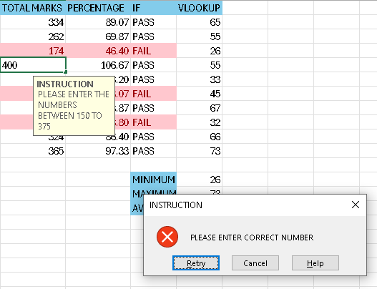
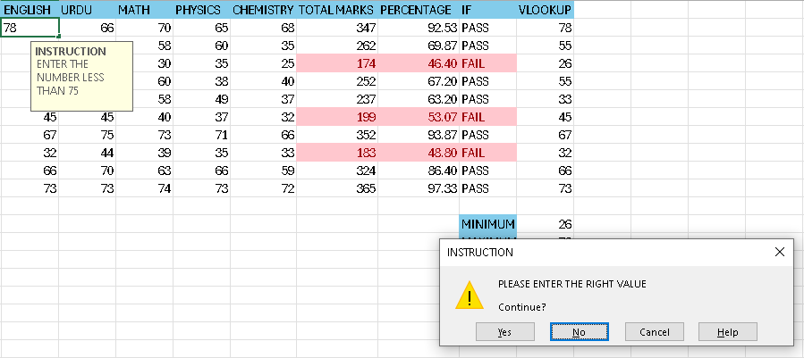
DATA VALITATION AND CONDITIONAL FORMATING
Restricted input between 150 to 375.
Displayed error message when invalid number entered.
Used conditional formatting for better data viSUALIZATION.

Slide 6
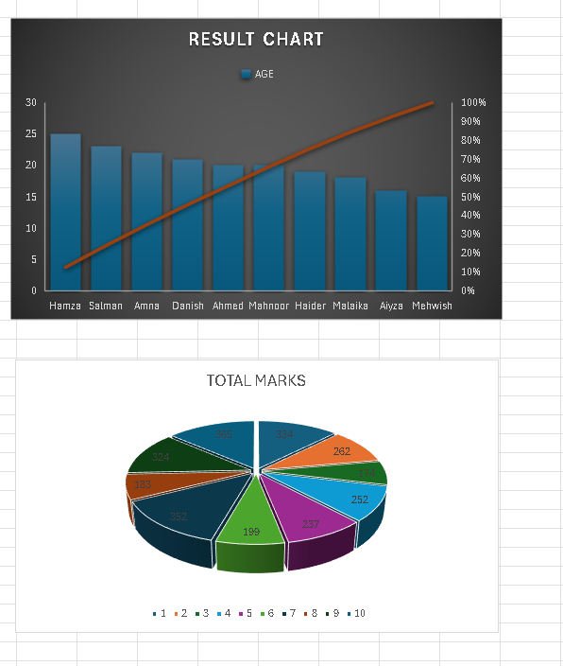
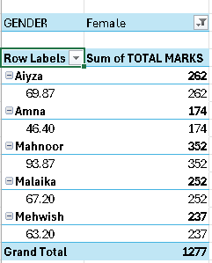
CHARTS AND PIVoT TABLE
Chart highlights overall growth\decline trends over the selected period.
Created pivot tables to sort, filter, and summarize data. Enhanced data analysis and reporting.

Slide 7
thank you

